Slide 1
STOR-609 Presentation
Vlad Bercovici Malcolm Connolly Rebekah Fearnhead Niharika Peddinenikalva

Slide 2
Summary of our findings
We believe we have managed to reproduce all figures from the original paper.
We found that the figures of winning percentages were different from those in the paper.

Slide 3
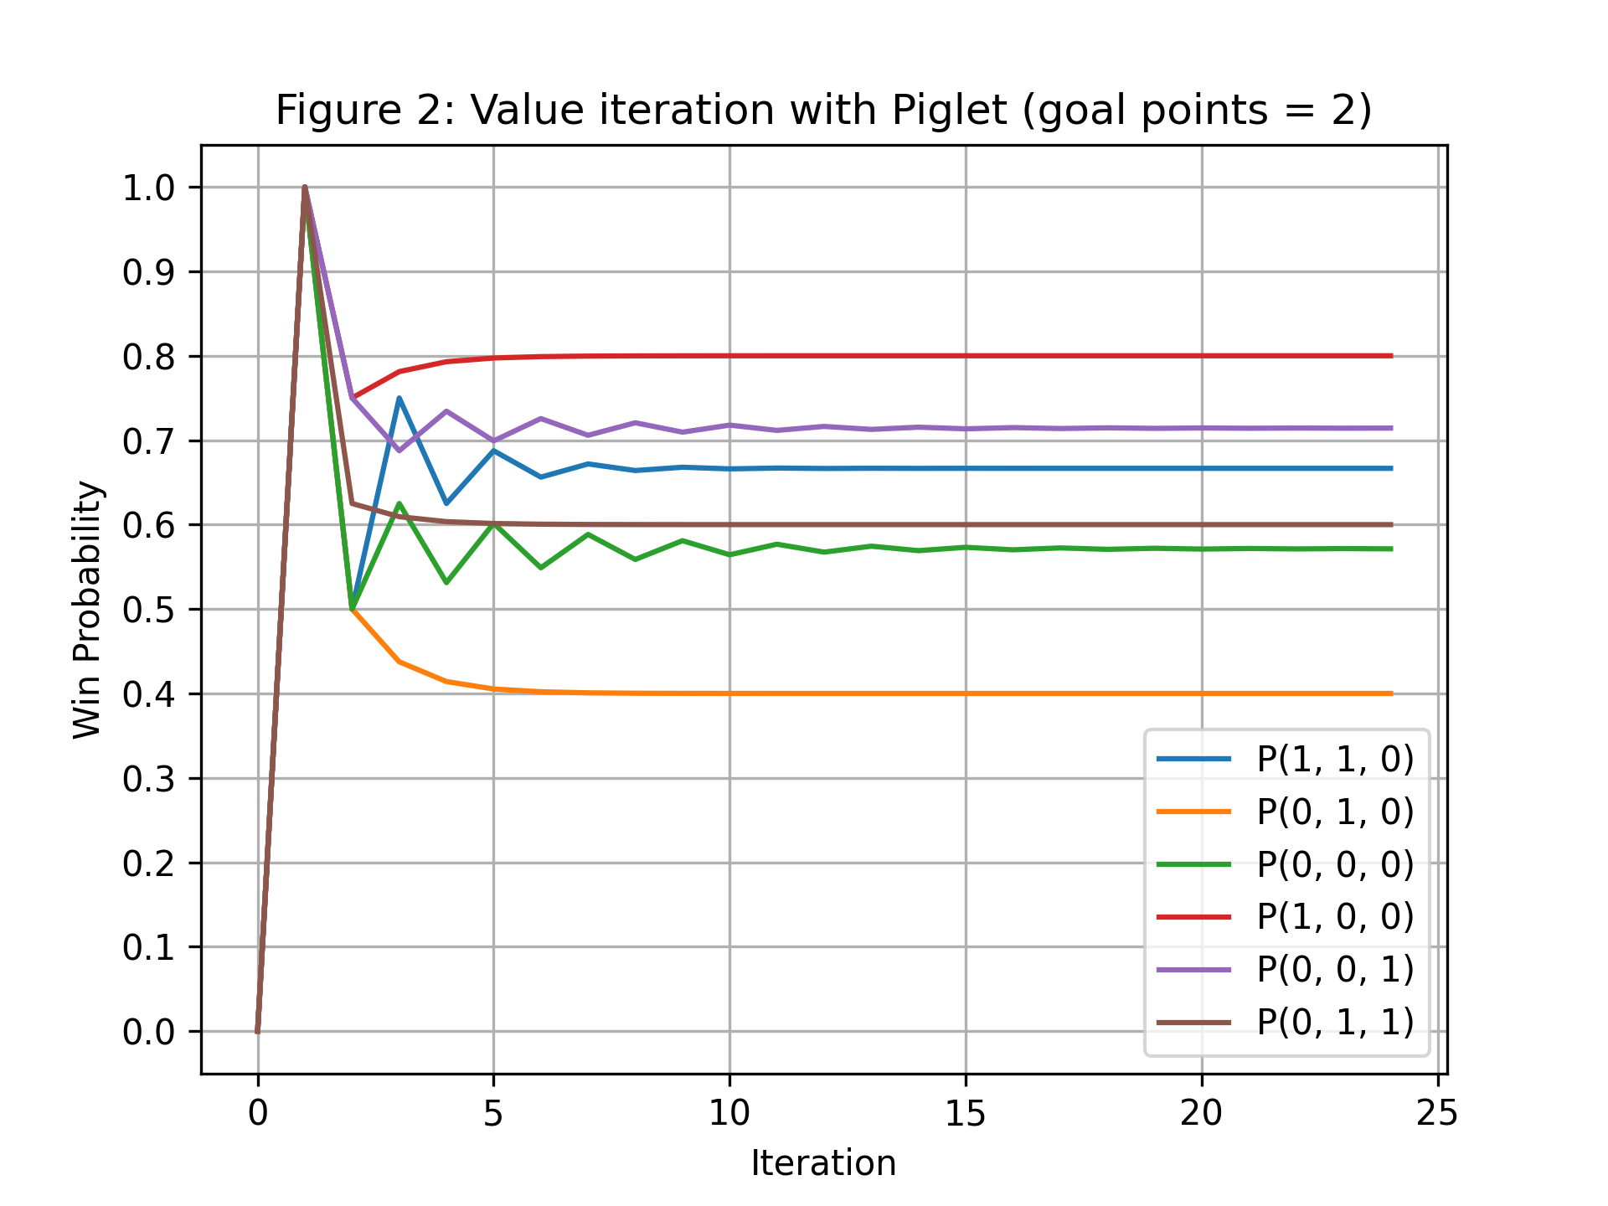
Optimal Piglet play (Figure 2)
Each of the lines represents how the estimates for each of the win probabilities changes as iterations of the algorithm are performed.
The win probability converges within the first $25$ iterations.

Slide 4
Optimal Pig play surface (Figure 3)
In the graph the boundary surface is shown between the states where rolling again is the optimal policy (in grey) and those where the optimal policy is to hold (transparent)
We use the optimal policy obtained from value iteration to plot all states where rolling is the found to be the optimal policy.

Slide 5
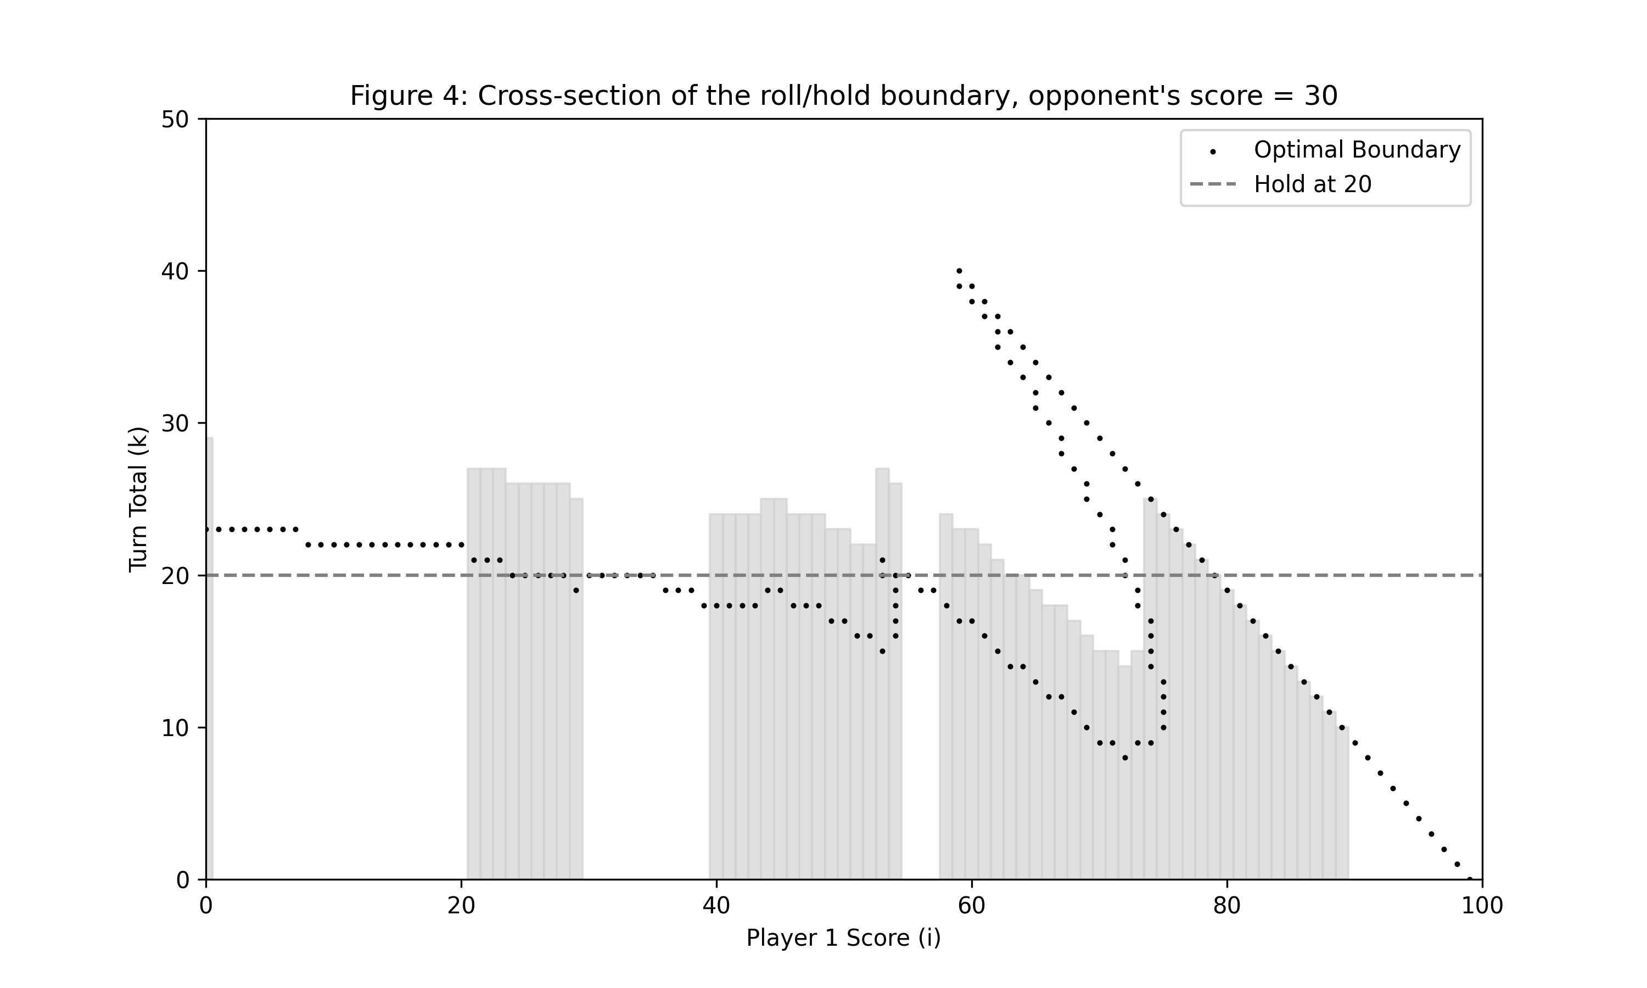
Roll/Hold Boundary plot (Figure 4)
Figure 4 is a cross-section of figure 3.
Figure 4 is easier to compare to the graph created with our results, as it is only in two dimensions.
For lower values of player 1’s score they want to roll while they have a turn total of up to. This value decreases until a player score of around at which point they wish to roll until they have won.

Slide 6
Reachable states (Figure 5)
Figure 5 shows all the states that can be reached with a player following the optimal policy.
There are $4$ gaps in the reachable states, as in the paper.
An optimal player with score of $0$ will never hold before reaching a turn total less than $21$ which can be seen in the graph.

Slide 7
Reachable states with optimal rolling (Figure 6)
Figure 6 is similar to Figure 3 but instead of showing the optimal policy for all states, it just shows the optimal policy for the states that are reachable as found in Figure 5.
This is created by looking at the reachable states found for Figure 5, showing only those states at which the optimal policy is to roll.

Slide 8
Winning probability contours (Figure 7)
Figure 7 shows contours of different winning probabilities computed from the optimal policy.
We draw a contour wherein the states have a win probability that is within a threshold $t$ from the desired probability, e.g. in the interval $x\%±t$.
The thresholds selected were manually selected for each of the $4$ probabilities in order to yield smooth surfaces.

Slide 9
5 Rs of Neller and Cresser
Replicability refers to when algorithm or solution can be recoded by someone else.
The methodology as described in the paper is not replicable, in particular the description of Value Iteration algorithm.
We were able to replicate their figures and recoded their implementation from their description.
Java code authors supplied for piglet was re-runnable and repeatable.
No code means not all Rs applicable.

Slide 10
Our work and the 5Rs (I)
Our code is re-runnable by a third party, and we provide a package.
Our results are repeatable, as we obtain the same optimal policy after convergence, and we specify iterations.
Our solution is reproducible, robust to different versions of python in future utilising sets, dictionaries and other base pythonic structures.
Our results are replicable, we explain methodology in detail, and provide pseudocode.

Slide 11
Our work and the 5Rs (II)
Our code is reusable for simple extensions of Pig such as goal-n-Pig, and routinely adaptable to different versions of Pig with equations (e.g. 2 6-sided dice losing with snake eyes, changes in input equation).
Further Piglet could be extended to have different goal numbers (twiglet, triglet, quiglet?).
Did not explore other extensions mentioned in paper such as jeopardy approach games.

